Slide 1
Nature and Scope of Financial Management

Slide 2
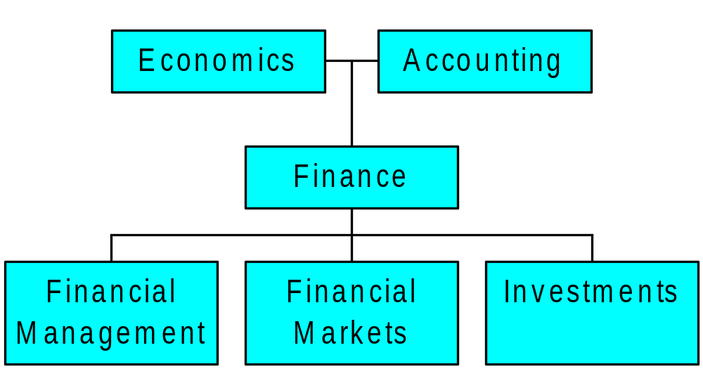
Field of Finance: An Overview

Slide 3
Meaning of Finance
Finance also is referred as the provision of money at the time when it is needed. Finance function is the procurement of funds and their effective utilization in business concerns.
According to Khan and Jain, “Finance is the art and science of managing money”
BUSINESS FINANCE
According to the Wheeler, “Business finance is that business activity which concerns with the acquisition and conversation of capital funds in meeting financial needs and overall objectives of a business enterprise”.
According to the Guthumann and Dougall, “Business finance can broadly be defined as the activity concerned with planning, raising, controlling, administering of the funds used in the business”.

Slide 4
Forms of Business Organization
Three major forms
  Sole proprietorship
  Partnership
    General
    Limited
  Corporation
    Limited liability company
Notes:
www: Clicking on the “Web surfer” will take you to a Web site that will provide a discussion about which form of business may be appropriate for an entrepreneur. The following pages will provide links to specific pages on the Web site that provide additional information about the legal aspects of each form of business, as well as a discussion of the advantages and disadvantages. The address is: http://www.nolo.com/encyclopedia/sb_ency.html#Subtopic16

Slide 5
Sole Proprietorship
Advantages
  Easiest to start
  Least regulated
  Single owner keeps all of the profits
  Taxed once as personal income
Disadvantages
  Limited to life of owner
  Equity capital limited to owner’s personal wealth
  Unlimited liability
  Difficult to sell ownership interest
Notes:
www: Click on the “Web surfer” for more information about sole proprietorships. If you click on the “--Sole Proprietorship” link, you will be taken to an index that will provide a link to information about husband and wife sole proprietorships.

Slide 6
Partnership
Advantages
  Two or more owners
  More capital available
  Relatively easy to start
  Income taxed once as personal income
Disadvantages
  Unlimited liability
    General partnership
    Limited partnership
  Partnership dissolves when one partner dies or wishes to sell
  Difficult to transfer ownership
Notes:
www: Click on the “Web surfer” for more information about partnerships. If you click on the “—Partnerships” link, you will go to an index that provides links to additional information about limited partnerships, partnership agreements, and buy-sell agreements.
Note that unlimited liability applies to all partners in a general partnership but only to the general partner(s) in a limited partnership
Written agreements are essential due to the unlimited liability.
Limited partners cannot be actively involved in the business or else they may be deemed general partners.

Slide 7
Corporation
Advantages
  Limited liability
  Unlimited life
  Separation of ownership and management
  Transfer of ownership is easy
  Easier to raise capital
Disadvantages
  Separation of ownership and management (agency problem)
  Double taxation (income taxed at the corporate rate and then dividends taxed at personal rate, while dividends paid are not tax deductible)
Notes:
www: Click on the “Web surfer” to go to a page that discusses corporations. If you click on the “—Corporations” link it will take you back to an index that provides links to additional information on corporations as well as limited liability corporations.
Discuss how separation of ownership and management can be both an advantage and a disadvantage:
Advantages
You can benefit from ownership in several different businesses (diversification)
You can take advantage of the expertise of others (comparative advantage)
It is easier to transfer ownership
Disadvantage
Agency problems if management goals and owner goals are not aligned
The instructor’s manual provides additional discussion of limited liability companies and S-corporations

Slide 8
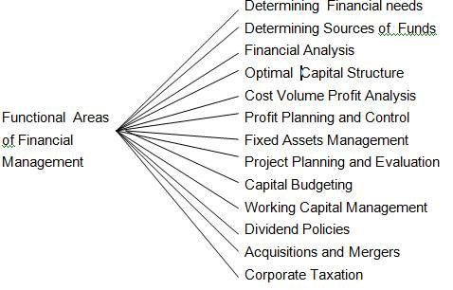

Slide 9
Investment Decisions
It tries to answer the question of “where to invest the funds”.
Whether in fixed assets or current assets depending upon the nature of business.
It deals with investment in assets .
How much to be invested in fixed assets which are for more than 1 year and current assets which are for less than 1 year.

Slide 10
Financing Decisions
It tries to answer the question of “where to raise the funds”.
What type of funds are required for business.
Whether long term funds or short term funds.
Long term funds are raised in capital Market which are raised for more than one year.
Short term funds are raised in money Market which are for less than one year.

Slide 11
Dividend Decisions
Dividend is the return paid on share .
How much dividend is to be distributed to the shareholders.
How much is to be retained earnings .
In which form the dividend is to be paid?
Dividend Policies adopted by the firm.
Procedure in payment of dividend.

Slide 12
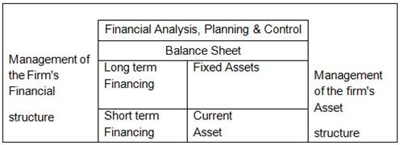
Key Activities of Financial Management

Slide 13
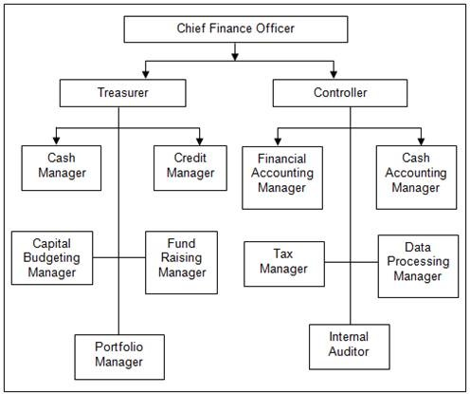
Finance function organization

Slide 14
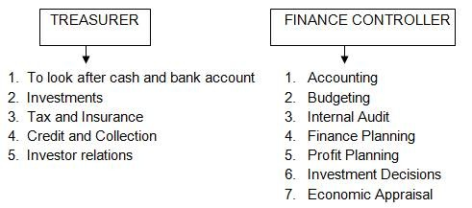
Functions of Treasurer and Controller

